Slide 1
US ACCIDENTS ANALYSIS
Group: Starks
Shiva Abhishek Varma Penmetsa
Priyanka Balla
Vineeth Reddy Chinthala
Pravallika Vallapuri

Slide 2
AGENDA
Introduction
Data Details
Architecture
AWS Implementation
Security
Insights through analysis
Conclusion
Future work

Slide 3
Introduction
One of the major concerns of the world are accidents and it is a challenge faced by governments across the globe. In recent decades, accident analysis has been the main area of research.

Slide 4
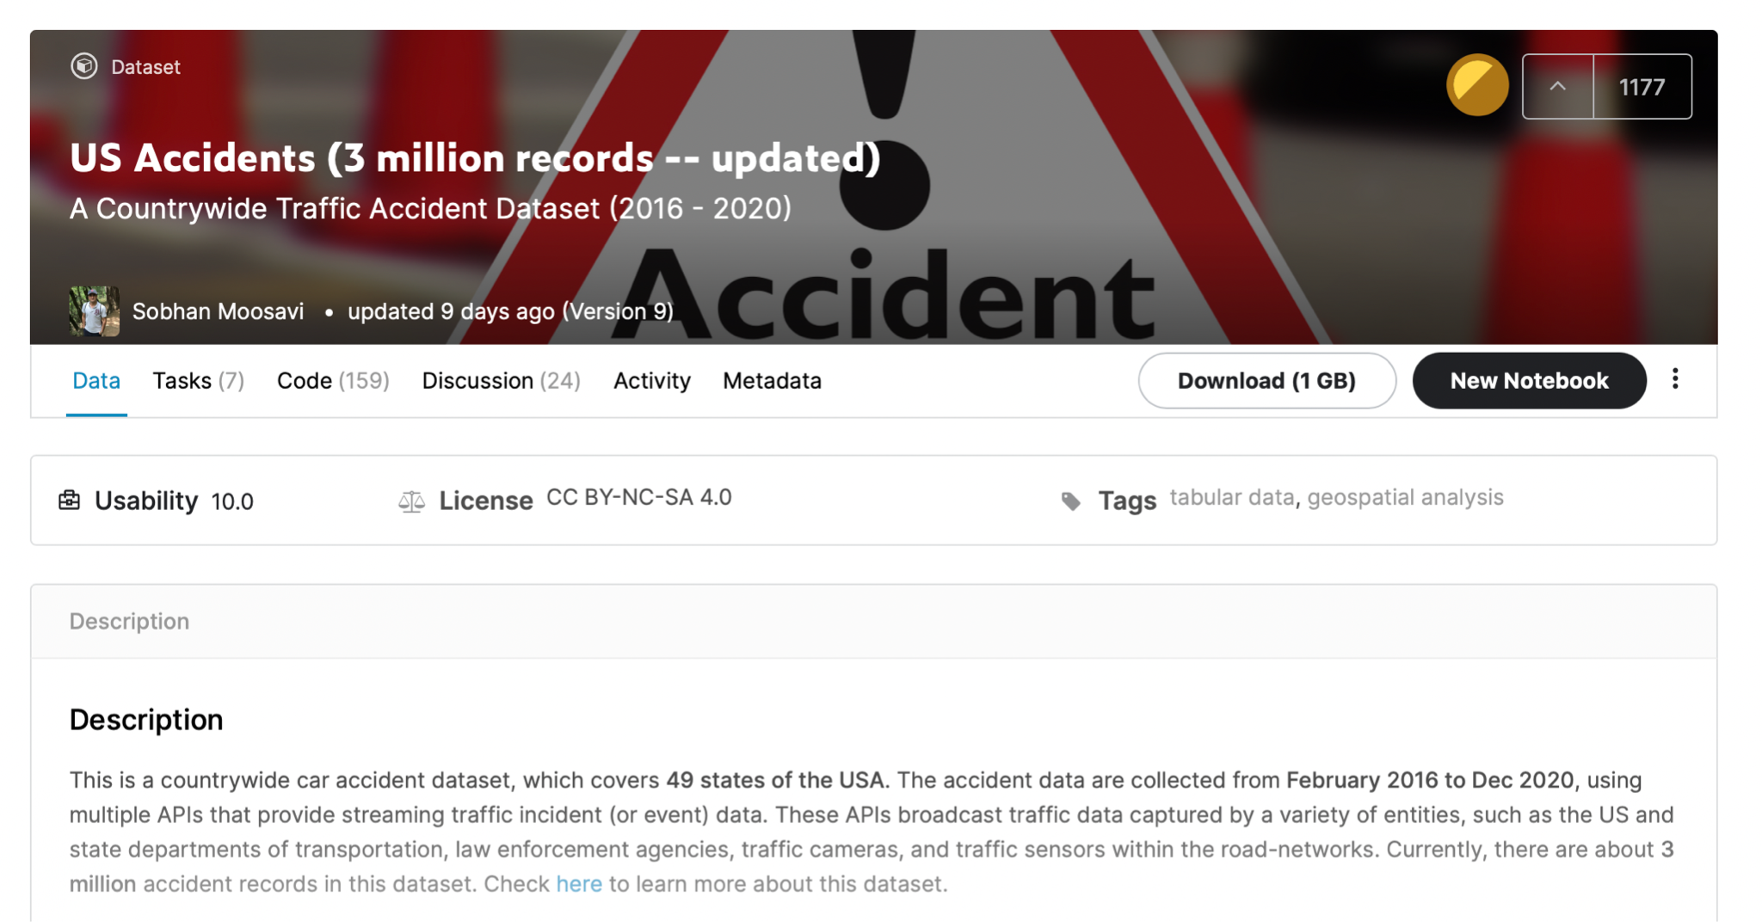
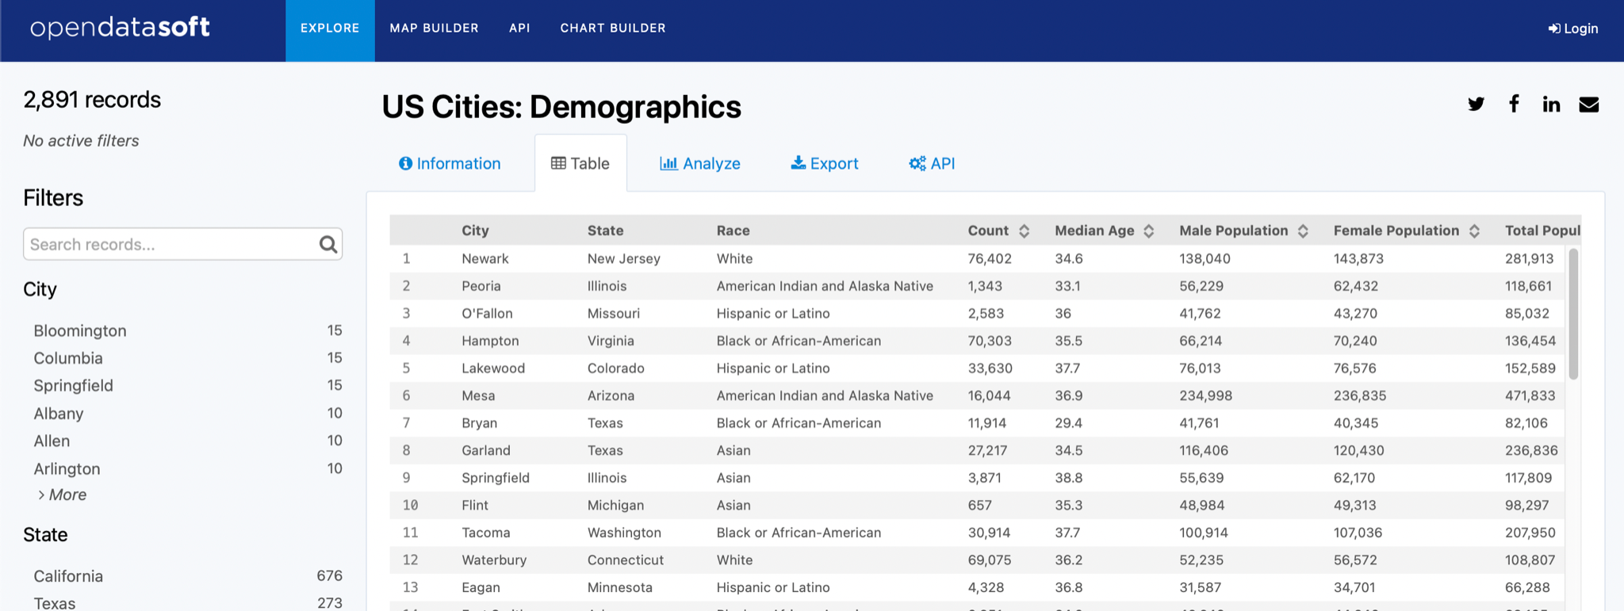
Data details
Kaggle
Opendatasoft

Slide 5
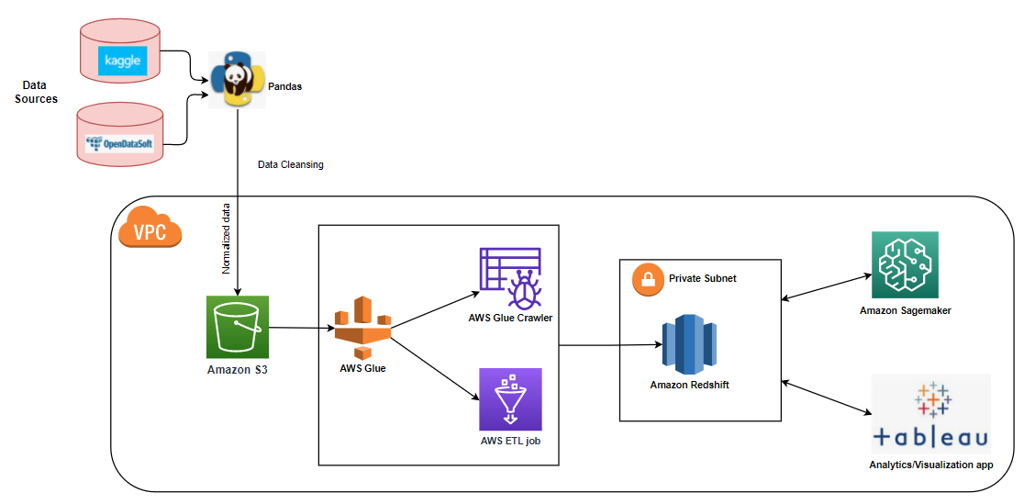
Architecture

Slide 6
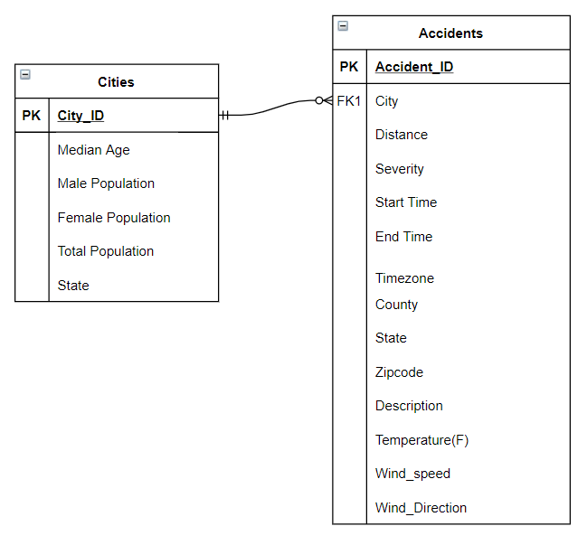
Data model

Slide 7
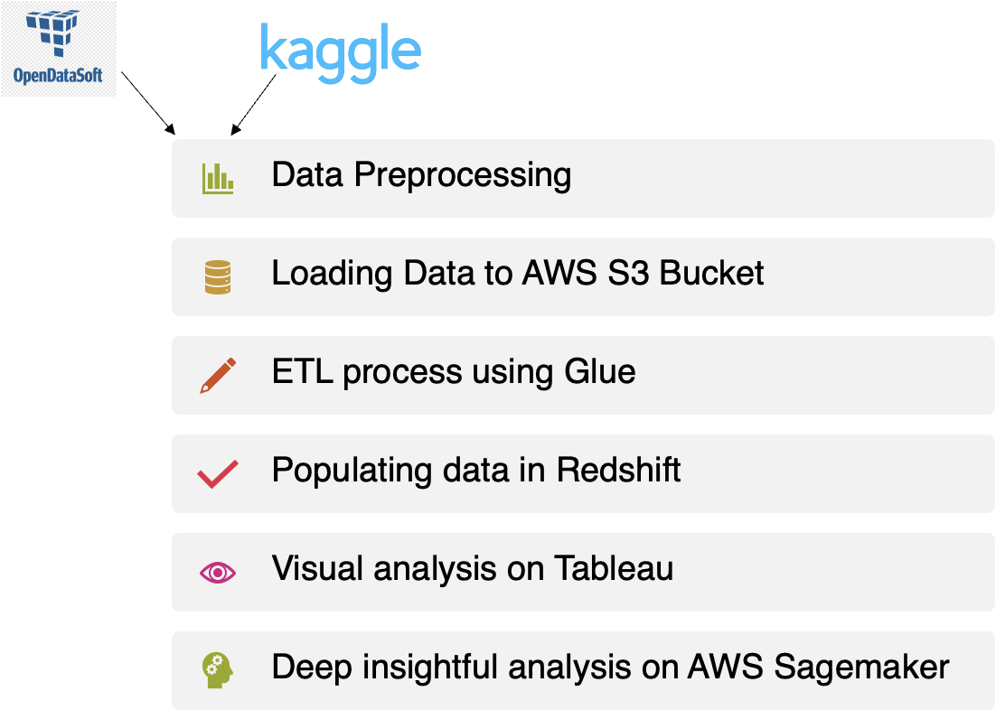
AWS Implementation Overview

Slide 8

Security
IAM: a web service for securely controlling access to AWS resources.
VPC: Provides a private area that is isolated from other users
Endpoint: enables private connections between VPC and supported AWS services.

Slide 9
Conclusion
We were able to analyze the causes of accidents. This project provides the knowledge about the location, time, temperature, and points of interest of an accident.
The analysis assists us in determining the best month, day, and time to travel. It can also help us determine accident prone areas in each state.

Slide 10
Future Work
Extend the analysis to all the countries.
We can develop a mobile app to send alerts before passing the accident-prone areas.
Using a machine-learning algorithm to help the general public determine the location of an occurrence based on the origin and destination locations, as well as the date and time of departure.

Slide 11
Thank you https://prezi.com/view/kKDOdw4GGH3AgHB1Runz/

